Slide 1

Interpretable Risk-Factor Dependency Modeling for Lung Cancer Prediction Using Probabilistic Graphical Models
Milestone 4: Final Submission
g1_apl_team | Priyam Modi, Rushin Modi, Jash Odedara

Slide 2
Problem, Importance and Scope
Problem: Learn conditional dependencies among lung-cancer survey risk factors and answer probabilistic queries P(LUNG_CANCER | evidence), including when only some variables are observed.
Why it matters: Clinical and survey data are often incomplete. A model that exposes its dependencies and reasons over any evidence subset is more inspectable than a fixed-input classifier.
Central question: Does a PC-learned Bayesian Network (BN) beat discriminative classifiers, or is its value elsewhere?
Scope: Observational, self-reported survey data (not a clinical cohort). Learned dependencies and DAG arrows are not causal findings. Nothing here supports diagnosis.

Slide 3
Dataset and Preprocessing
Dataset audit | Value
Raw records / columns | 309 / 16
Exact duplicates removed | 33
Unique records | 276
YES / NO labels | 238 / 38
Always-YES accuracy | 0.862
Source: Kaggle Lung Cancer Survey dataset
BN input: AGE discretized into 3 bins; all variables categorical
Baselines: median imputation and standardization for AGE; mode imputation for binary features
No leakage: all learned transforms fitted on training partitions only; duplicates removed before CV
Consequence: accuracy is uninformative, so we use AUROC, AUPRC, F1(NO), Brier, log-loss, ECE

Slide 4
Why a PGM? Formulation
Joint model: V = {X1,...,X15, Y}, Y = LUNG_CANCER. A BN factorizes P(V) = Π P(Xi | Pa(Xi)) over a DAG G.
Posterior query: P(Y=y | e) = P(Y=y, e) / Σy′ P(Y=y′, e) for any evidence subset e.
Why PGM: explicit dependency graph, factorized joint, and one model answers queries for any observed subset by marginalization.
Why not just a classifier: a classifier maps a fixed feature vector to a score; missing inputs must be imputed.
Two goals, kept separate: (1) prediction quality vs baselines; (2) partial-evidence inference.

Slide 5
Representation: PC-Learned Dependency Structure
Skeleton: PC with conditional likelihood-ratio (G) test, α = 0.05, max conditioning set 3. Result: 18 edges over 16 nodes (density 0.150).
Orientation: colliders via separating sets, then Meek rules; CPDAG extended to a DAG. GENDER and AGE kept exogenous.
Ablation: 4 SMOKING edges (WHEEZING, YELLOW_FINGERS, CHRONIC_DISEASE, COUGHING) imposed externally: 22 edges. These are modelling constraints, not PC discoveries.
Conditional independencies: each node is independent of its non-descendants given its parents (local Markov property).
Caveat: arrow directions in the DAG extension are not causal claims.

Slide 6
Learning: Structure and Parameters
Structure learning: constraint-based PC; edges removed when independence is not rejected; separating sets stored for orientation.
Parameter learning: CPTs by Dirichlet smoothing, α0 = 1
θ̂ijk = (Nijk + α0) / (Nij + ri·α0)
Terms: Nijk = count of state k of node i under parent configuration j; ri = number of states; α0 = 1.
Why smoothing: avoids zero probabilities for unseen parent configurations on only 276 records.
Assumptions: causal sufficiency, Markov property, faithfulness.

Slide 7
Inference: Exact Variable Elimination
Method: multiply the relevant factors, sum out non-query non-evidence variables, normalize.
Query: P(LUNG_CANCER = 1 | e) for any evidence subset e (0 to 15 observed variables).
Missing evidence: unobserved features are marginalized exactly, not imputed.
Trade-off: exact and fast on this 16-node, binary/ternary network; cost grows with treewidth, so larger graphs would need approximation.
Validation: compared with brute-force enumeration (next slides).

Slide 8
Experimental Setup, Baselines and KPIs
Protocol: RepeatedStratifiedKFold, 5 folds x 5 repeats, seed 516, identical splits for all models; out-of-fold predictions pooled per repeat.
Baselines: logistic regression (balanced weights), RBF-SVM (C=1, balanced), MLP (32,16; L2 0.01; early stopping).
Proposed: PC-BN (plain) and PC-BN (protected SMOKING edges).
KPIs: AUROC, AUPRC, F1(NO) at threshold 0.5, Brier, log-loss, ECE (10 bins), accuracy.
Statistics: mean ± SD, 95% t-intervals (4 d.f.), paired Wilcoxon with Holm adjustment.

Slide 9
Main Results: Repeated-CV KPIs
Model | AUROC ↑ | AUPRC ↑ | F1(NO) ↑ | Brier ↓ | Log-loss ↓ | ECE ↓ | Acc.
Logistic Reg. | 0.938±0.009 | 0.990±0.002 | 0.623±0.027 | 0.091±0.005 | 0.301±0.013 | 0.118±0.003 | 0.864
SVM (RBF) | 0.912±0.020 | 0.984±0.005 | 0.508±0.072 | 0.079±0.005 | 0.253±0.016 | 0.052±0.011 | 0.882
PC-BN (plain) | 0.822±0.008 | 0.967±0.003 | 0.187±0.080 | 0.099±0.004 | 0.316±0.010 | 0.043±0.005 | 0.854
PC-BN (protected) | 0.820±0.009 | 0.967±0.003 | 0.170±0.080 | 0.100±0.003 | 0.317±0.010 | 0.040±0.006 | 0.854
MLP | 0.566±0.127 | 0.883±0.051 | 0.085±0.121 | 0.191±0.021 | 0.572±0.045 | 0.268±0.034 | 0.843
Mean ± SD over five repeats of five-fold CV. Best per column in bold. The BN is not the best classifier.

Slide 10
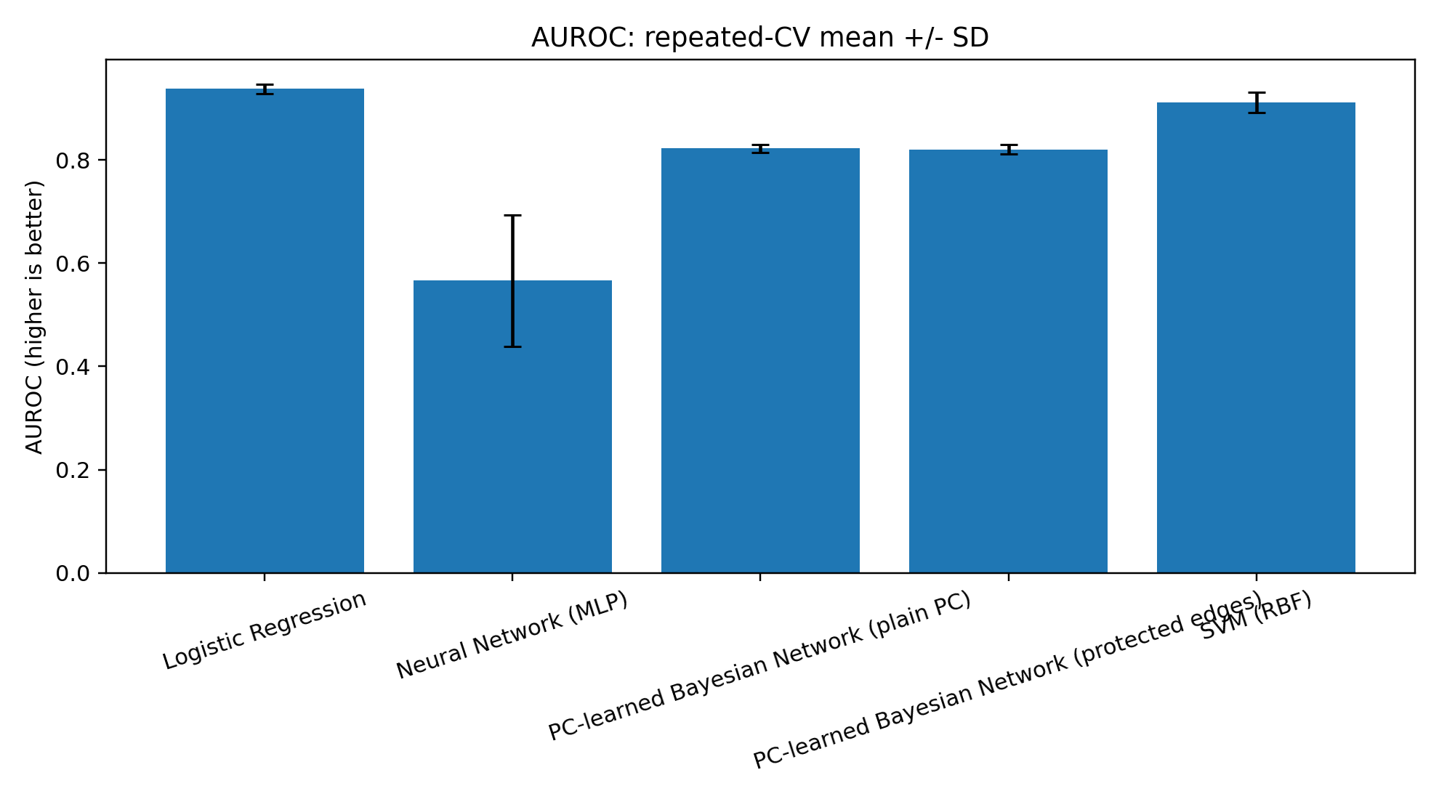
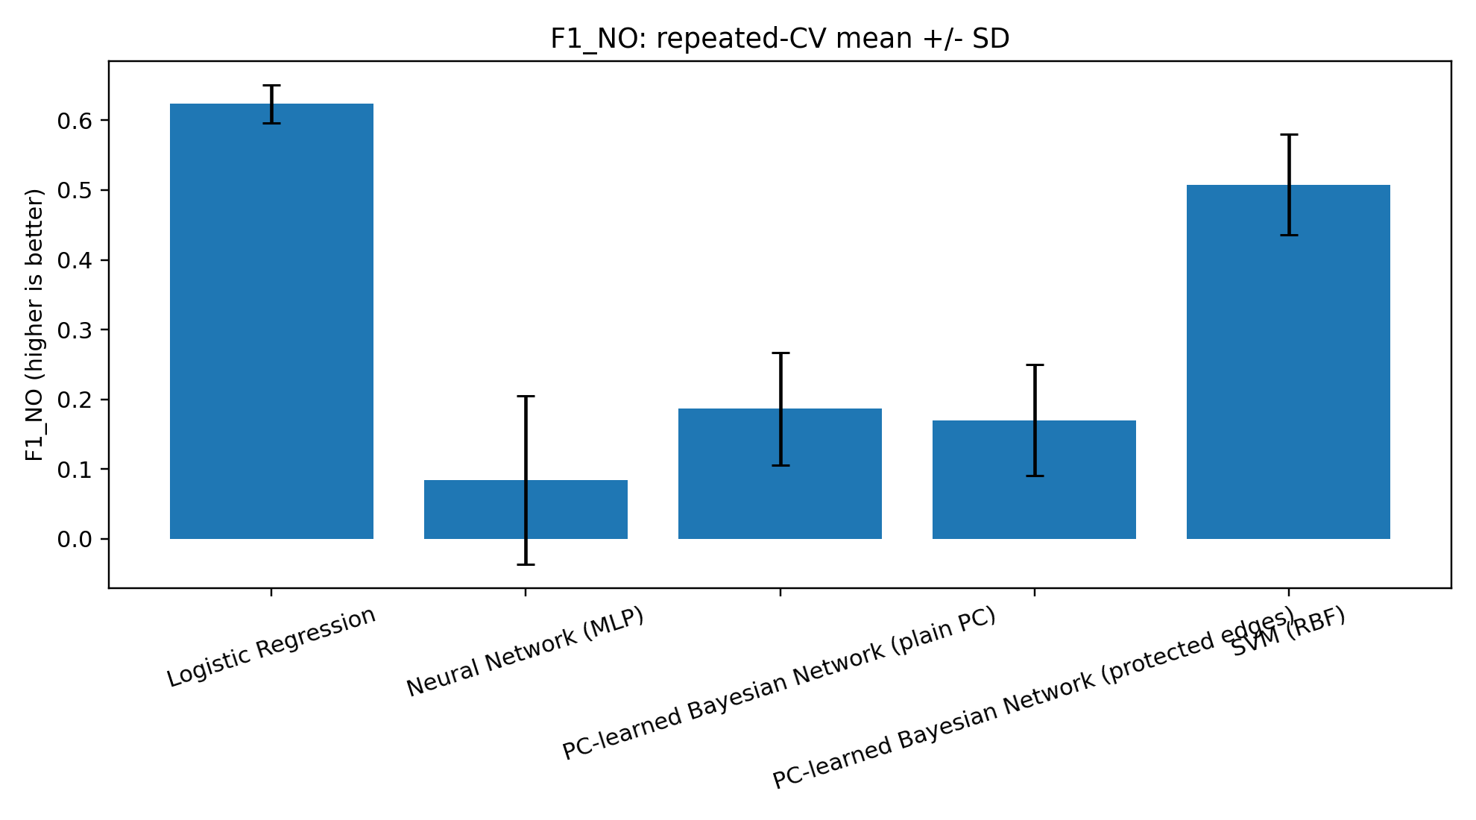
KPI Comparison: AUROC and F1(NO)
Fig. 1: AUROC comparison across the predictive models
Fig. 2: F1 for the NO class at threshold 0.5
LR leads on AUROC, AUPRC and F1(NO); the PC-BN is intermediate on AUROC.
BN recognizes 12.6% of NO cases at threshold 0.5 (LR 81.6%, SVM 44.7%): it favors the majority class; the threshold was not tuned.
MLP is a compact configured baseline, not a verdict on neural networks.

Slide 11
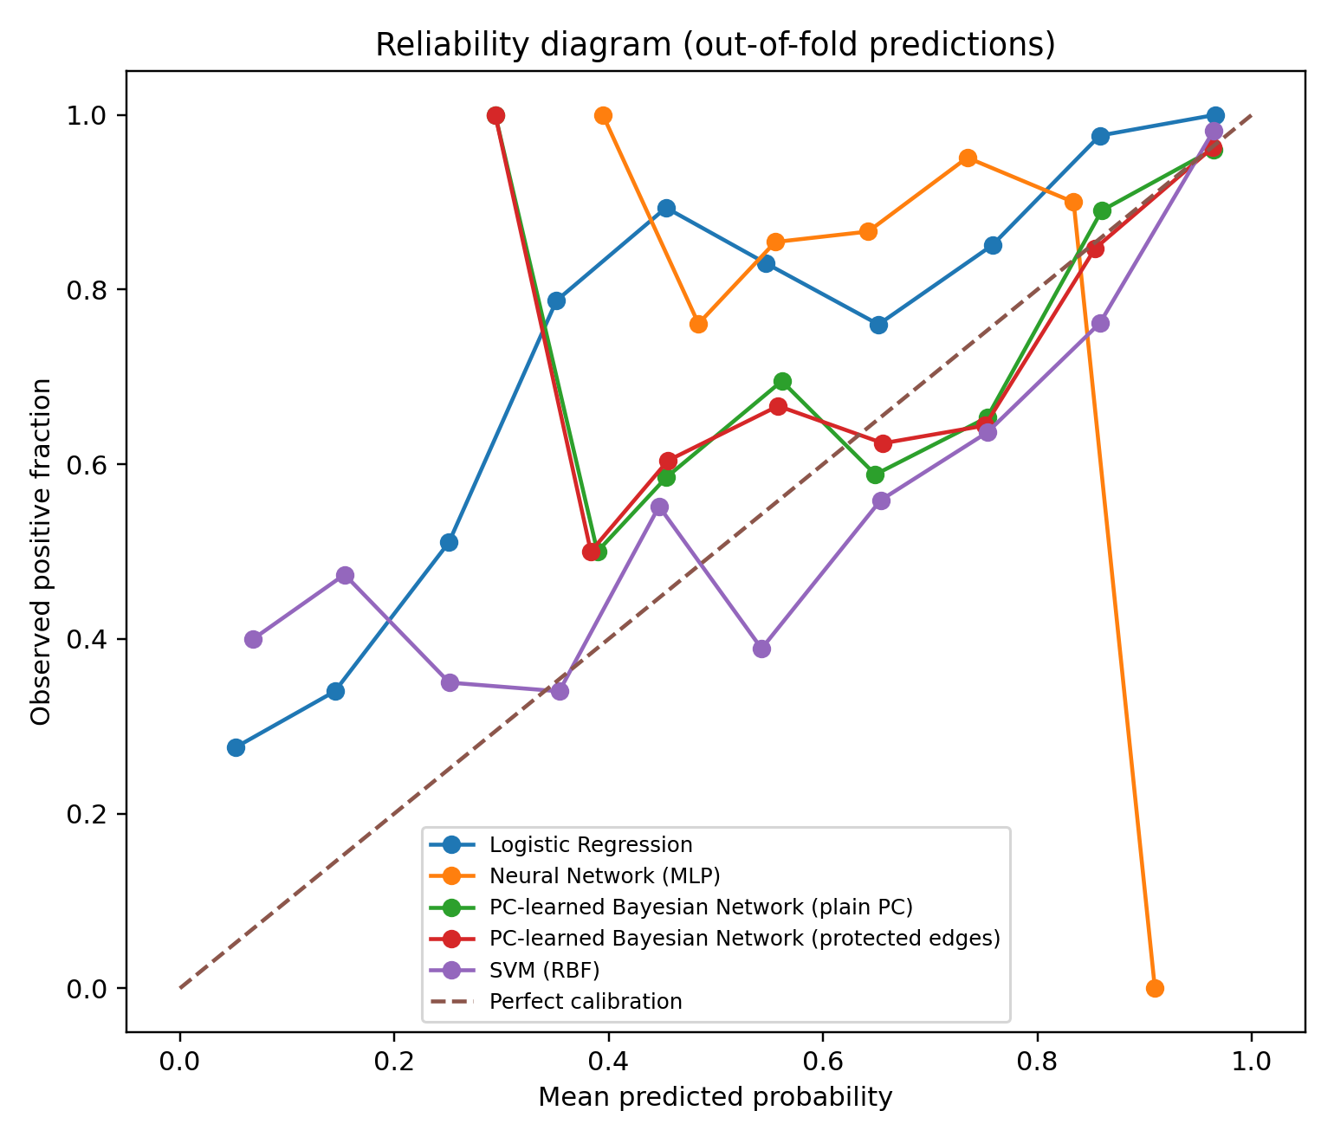
Probability Quality and Calibration
Best Brier / log-loss: SVM (0.079 / 0.253).
Lowest ECE: PC-BN (0.043 plain, 0.040 protected).
Reading: ECE averages bin gaps; Brier and log-loss penalize per-sample error. Low ECE alone is not superior probability quality.
Caution: only 38 NO cases, so extreme bins are sparse.
Fig. 3: Reliability diagram, pooled out-of-fold predictions

Slide 12
Statistical Analysis
Paired differences (5 repeats): LR minus BN: AUROC +0.115, F1(NO) +0.437. SVM minus BN: AUROC +0.090, F1(NO) +0.321.
Tests: Holm-adjusted Wilcoxon p = 0.25 for both comparisons (unadjusted 0.0625, the minimum attainable with 5 pairs).
Interpretation: report direction and magnitude, not a binary significance claim. Repeats reuse the same 276 records, so tests are exploratory.
Protected edges: no measurable predictive gain (AUROC 0.820 vs 0.822).
Uncertainty: all metrics reported as mean ± SD and 95% t-intervals.

Slide 13
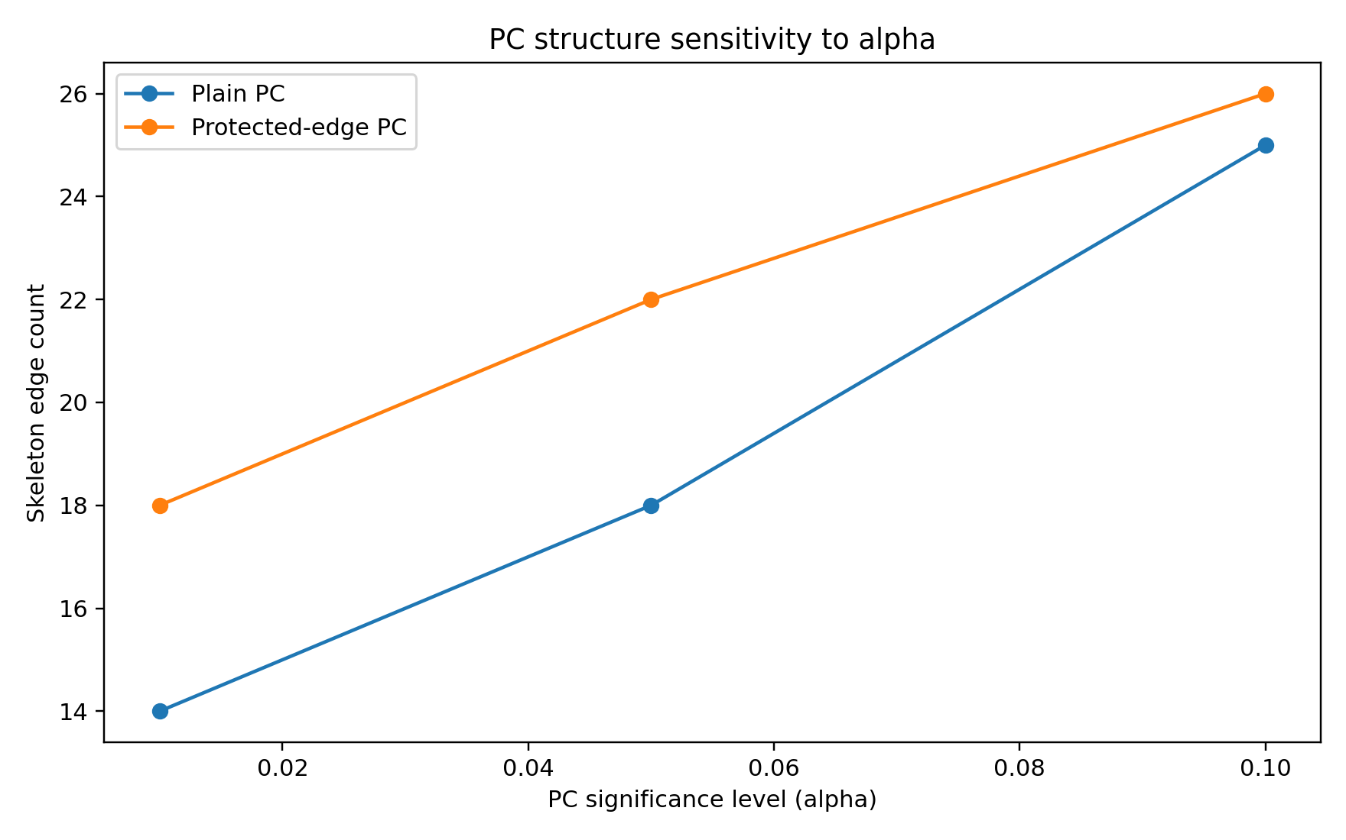
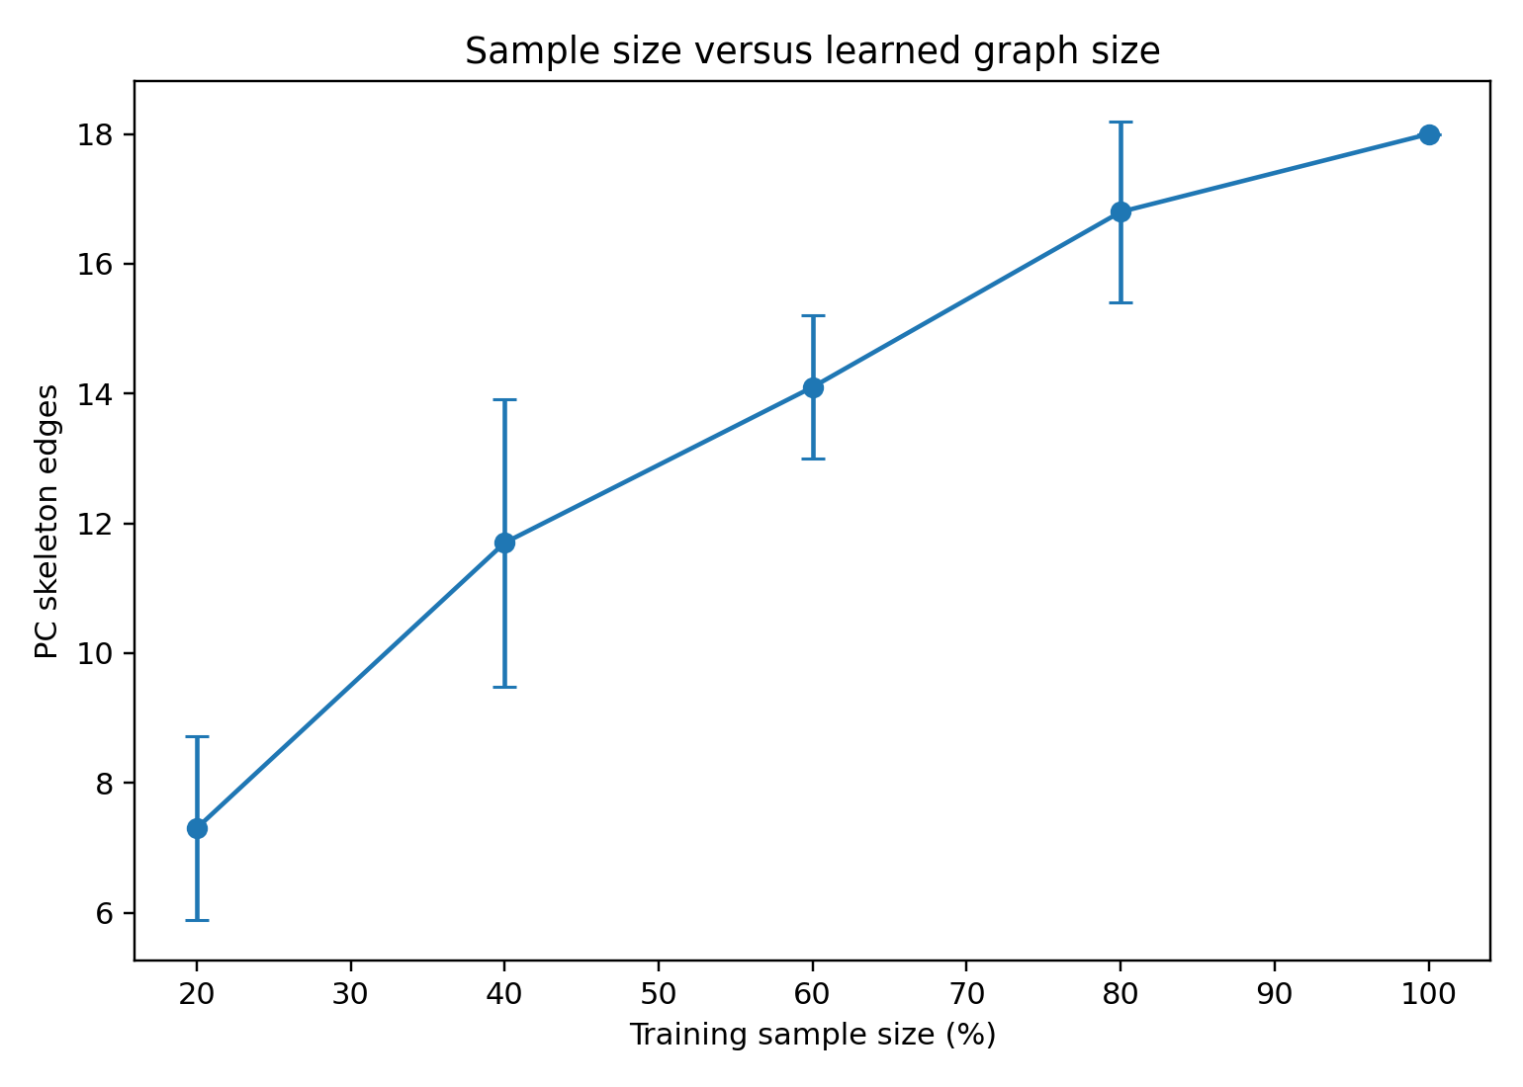
Structure Stability and Sample Size
Fig. 4: PC skeleton edge count vs significance level
Fig. 6: PC skeleton edge count vs training sample size
Alpha sensitivity: plain PC has 14 / 18 / 25 edges at α = 0.01 / 0.05 / 0.10 (protected: 18 / 22 / 26). Target neighbours unchanged from 0.01 to 0.05; ALCOHOL_CONSUMING and FATIGUE added at 0.10.
Sample size: mean edges 7.3±1.4 at 55 samples to 16.8±1.4 at 221 (full data: 18); no plateau between 80% and 100%.

Slide 14
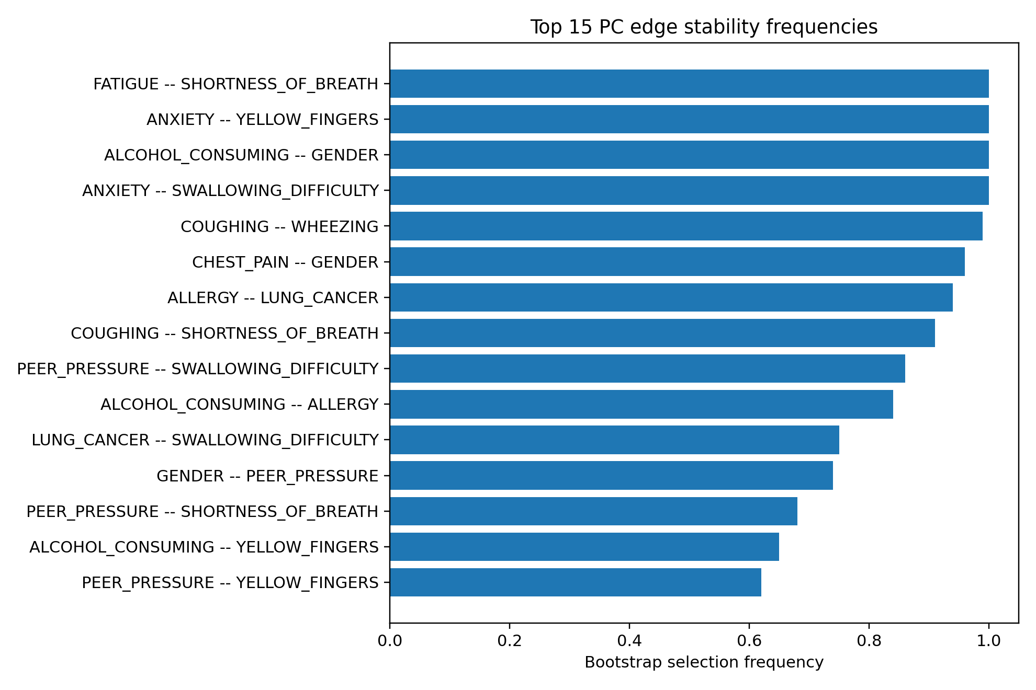
Bootstrap Edge Stability
Result: the 100-resample bootstrap identifies a stable core of dependencies.
Less stable: some target-adjacent edges.
Implication: the target-neighbour set should not be treated as definitively recovered.
Graphical lasso: 82 edges (density 0.683) vs 18 to 22 for PC; all PC edges are contained in it, but it models Gaussian dependence while most variables are binary.
Fig. 5: Top bootstrap edge-selection frequencies (100 resamples)

Slide 15
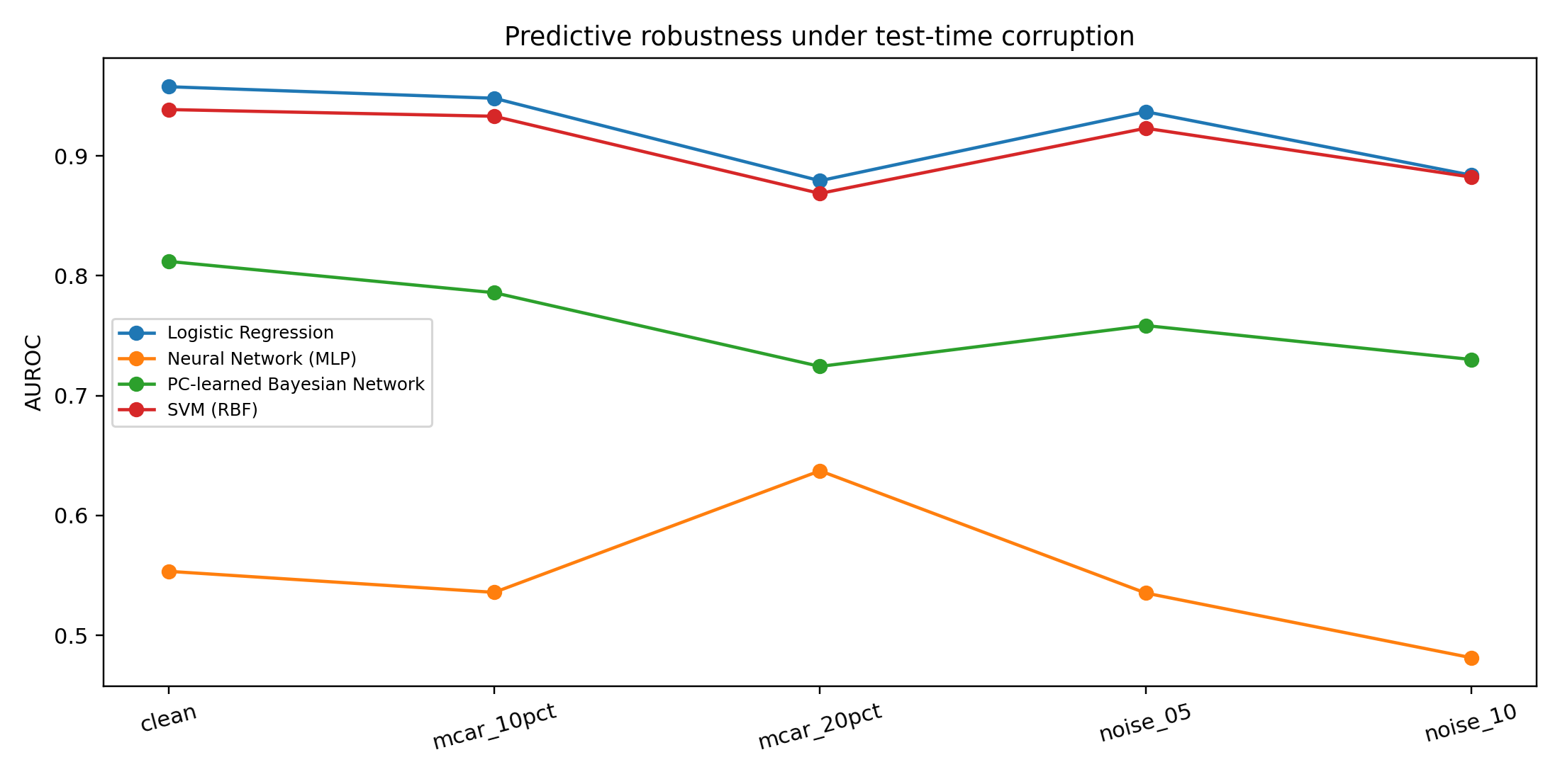
Robustness Under Feature Corruption
Setup: train on clean folds, corrupt held-out features (MCAR or noise); one five-fold split.
20% MCAR AUROC: LR 0.879, SVM 0.869, BN 0.724.
10% noise AUROC: LR 0.884, SVM 0.882, BN 0.730.
Ranking kept: LR ≳ SVM > BN > MLP.
Note: this test uses train-fold imputation, so it does not test the BN’s exact marginalization.
Fig. 7: AUROC under held-out feature corruption (single five-fold split)

Slide 16
Exact Inference Validation and Joint Likelihood
VE vs brute force: evidence sizes 0 to 15, three random posterior queries per size. Maximum absolute difference 1.11 × 10⁻¹⁶.
Latency: mean VE time 0.16 to 0.56 ms vs 2.17 to 3.31 ms for brute force. Implementation- and machine-dependent; not a scalability result.
Joint BN NLL: 10.3938 nats per test sample (total 582.0523 nats; 56 test samples). This is a joint score, not comparable to target-only log-loss of LR or SVM.
Conclusion: VE is numerically correct for the tested network and queries.

Slide 17
Missing Evidence: Marginalization vs Imputation
Missing | Method | AUROC | AUPRC | Brier | Log-loss
10% | Marginalize | 0.831 | 0.964 | 0.090 | 0.304
10% | Impute | 0.725 | 0.933 | 0.102 | 0.366
20% | Marginalize | 0.824 | 0.965 | 0.101 | 0.326
20% | Impute | 0.574 | 0.890 | 0.127 | 0.445
Exploratory: one stratified 80/20 holdout (220 train / 56 test) and one mask realization. Promising, not statistically established; repeated holdouts and masks are needed.

Slide 18
SOTA Positioning: Neural Graphical Models
Anchor: Neural Graphical Models (Shrivastava and Chajewska, 2022): graph-structured neural parameterizations with graph-adherence regularization.
Reported there: lung-cancer 5-fold values 0.95±0.02 (LR) and 0.96±0.01 (NGM); the metric is not stated and data handling differs, so not comparable to our AUROC.
Our repositioning: we evaluate a discrete PC-learned BN against LR, SVM and MLP. No NGM was implemented; we do not claim to reproduce or outperform it.
Revised from M1: the BN is not the best predictor; its contribution is an inspectable dependency model plus exact partial-evidence inference.

Slide 19
Is the PGM Better? Final Verdict
Capability | Verdict | Evidence
Predictive discrimination | No | LR 0.938, SVM 0.912 vs BN 0.822 AUROC
Probability calibration | Mixed | Lowest ECE; SVM best Brier and log-loss
Dependency representation | Yes | Stable core graph; sensitive to α and sample size
Exact partial-evidence inference | Yes | VE = brute force to 1.11×10⁻¹⁶
Missing evidence | Preliminary | Beats imputation on one holdout only
The PGM is not universally better. Its defensible value is explicit structure and exact reasoning under arbitrary evidence.

Slide 20
Limitations
Data: 276 unique self-reported records, 38 NO cases; not a clinical cohort.
Statistics: repeated-CV tests reuse the same records; p-values are exploratory.
Small experiments: missing-evidence and joint-NLL use one 80/20 split (56 test cases); VE check uses 3 queries per size.
Structure learning: depends on CI test, α, conditioning cap and sparse-table behavior; no ground-truth graph, so no structural recovery metric.
Constraints: protected SMOKING edges are imposed; MLP is a compact baseline; no NGM implemented; no medical use.

Slide 21
What We Learned and Next Research Step
Learned: a PGM should be judged on structure and exact inference, not only on classifier metrics; honest repositioning is a result.
Next: repeat missing-evidence tests over many splits and masks.
Next: tune thresholds and baselines inside training data; try alternative CI tests for sparse tables.
Next: synthetic data with a known graph for structural Hamming distance.
Next: implement a graph-constrained NGM; seek external clinical validation.

Slide 22
Reproducibility and Team
Config: seed 516; 5x5 stratified CV; PC α = 0.05, max conditioning set 3; Dirichlet α0 = 1; holdout 80/20 (220/56).
Package: source code, README, dataset reference, result CSVs and figures in the M4 GitHub folder.
Member | Primary responsibility
Priyam Modi | PC algorithm, representation, inference and learning design, KPI design
Rushin Modi | Problem framing, dataset and preprocessing, baselines, timeline
Jash Odedara | BN vs MN theory, KPI computation and logging, repository structure

Slide 23
References
H. Shrivastava and U. Chajewska, “Neural Graphical Models,” arXiv:2210.00453, 2022.
N. Alaswad, “Lung Cancer Dataset,” Kaggle. kaggle.com/datasets/nancyalaswad90/lung-cancer
P. Spirtes, C. Glymour, and R. Scheines, Causation, Prediction, and Search, 2nd ed., MIT Press, 2000.
D. Colombo and M. H. Maathuis, “Order-independent constraint-based causal structure learning,” JMLR, vol. 15, pp. 3741–3782, 2014.
J. Friedman, T. Hastie, and R. Tibshirani, “Sparse inverse covariance estimation with the graphical lasso,” Biostatistics, 9(3), 2008.
C. Guo et al., “On calibration of modern neural networks,” ICML, 2017.
C. Nadeau and Y. Bengio, “Inference for the generalization error,” Machine Learning, 52, 2003.
Rushin Modi - AU2440028 | Priyam Modi - AU2440030 | Jash Odedara - AU2440096

